Slide 1

Stage 4 Slot Machines Course Designer: Jordan Rogers
Slot Machines is a 27 round, 135 point Comstock long course. There are 12 USPSA targets and 3 steel targets. The best two hits per target will score. Steel must fall to score. The start signal is audible.
The Handgun start position is standing inside any shooting area with heels touching any fault line. Handgun loaded and holstered and wrists below belt. The PCC start position is standing inside any shooting area with heels touching any fault line. PCC loaded and stock touching belt
On the audible start signal, engage targets from within the shooting areas.

Slide 2
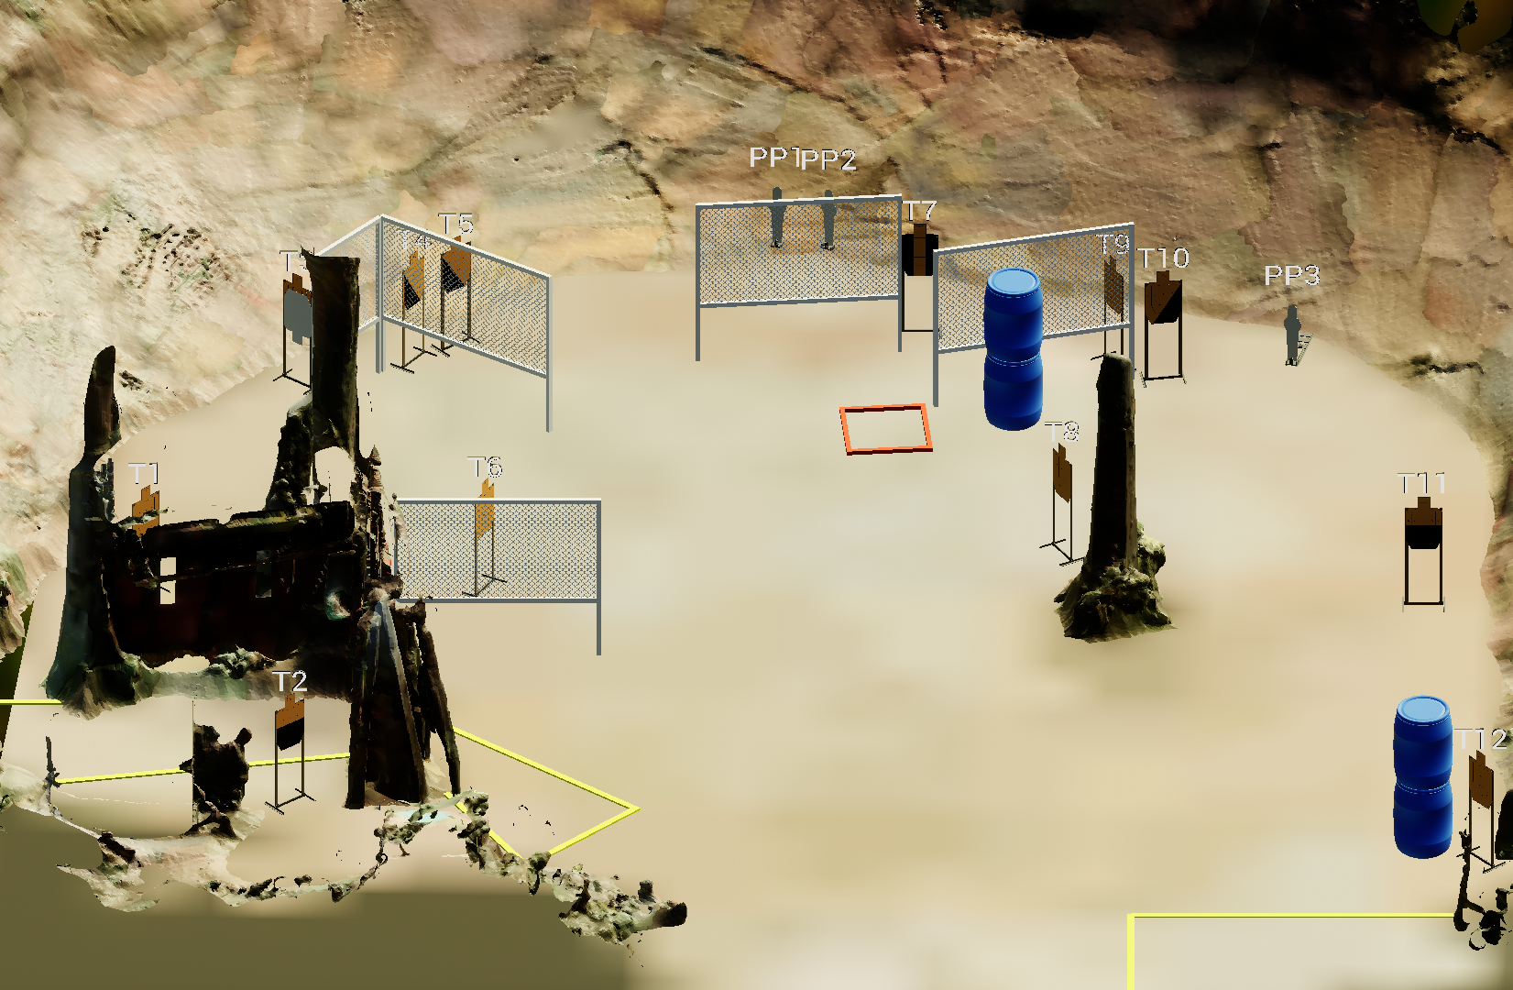
 | Stage 4 Slot Machines Course Designer: Jordan Rogers

